Slide 1
Mojaloop Workstream Governance Guidelines
Simeon Oriko
Director of Community
Mojaloop Foundation

Slide 2
What Makes a Project an Official Mojaloop Workstream?
Workstream Definition
Resources
Approval
Workstream Lead
Operations:
- Clear description
- Objectives for the PI
- Business justification
- Acceptance criteria
- Minimum 2 active contributors
- Reviewed & accepted by Product Council
- Must align with Product Council objectives
- Included in product roadmap
- Leadership, organizational, and technical skills
- Familiarity with Mojaloop ecosystem
- Committed for full PI cycle
- Weekly/fortnightly public meetings
- Public issue tracking on GitHub
- Sprint reviews (bi-weekly recommended)

Slide 3
Workstream Lead Responsibilities (1/2)
Run regular workstream meetings
Report progress fortnightly via Community Central:
Completed tasks
Delays
Updated backlog
Upcoming tasks
Report to Product Director/Product Council
Ensure adherence to:
Mojaloop design & code review processes
Quality standards (style, testing, documentation)
GitHub tracking

Slide 4
Workstream Lead Responsibilities (2/2)
01
02
03
04
05
06
07
Ensure code testing & external reviews
Guide strategic direction with Product Manager/Product Council
Facilitate feature development & coding
Manage contributions, triage issues, user support
Handle bug reporting/fixes
Manage technical debt
Maintain basic documentation

Slide 5
Relationship with Community Governance Councils
Role of the Design Authority (DA)
Role of the Change Control Board (CCB)
Role of the Community Council (CoCo)
Approves design decisions
Conducts regular design reviews
Reviews new features
Reviews API change proposals
Conflict escalation/resolution
Oversees governance changes and proposals

Slide 6
What MLF Provides
Development environments, tools, and platforms
Support for testing, releases, and publishing
Advocacy and community visibility
Governance and resource matchmaking
Guidance and advice

Slide 7
Workstream Status Characterization
Reviewed monthly by Product Director
Status types:
Active
Inactive (reason stated)
On Hold (reason stated)
Closed (reason stated)
https://community.mojaloop.io/active-workstreams/

Slide 8
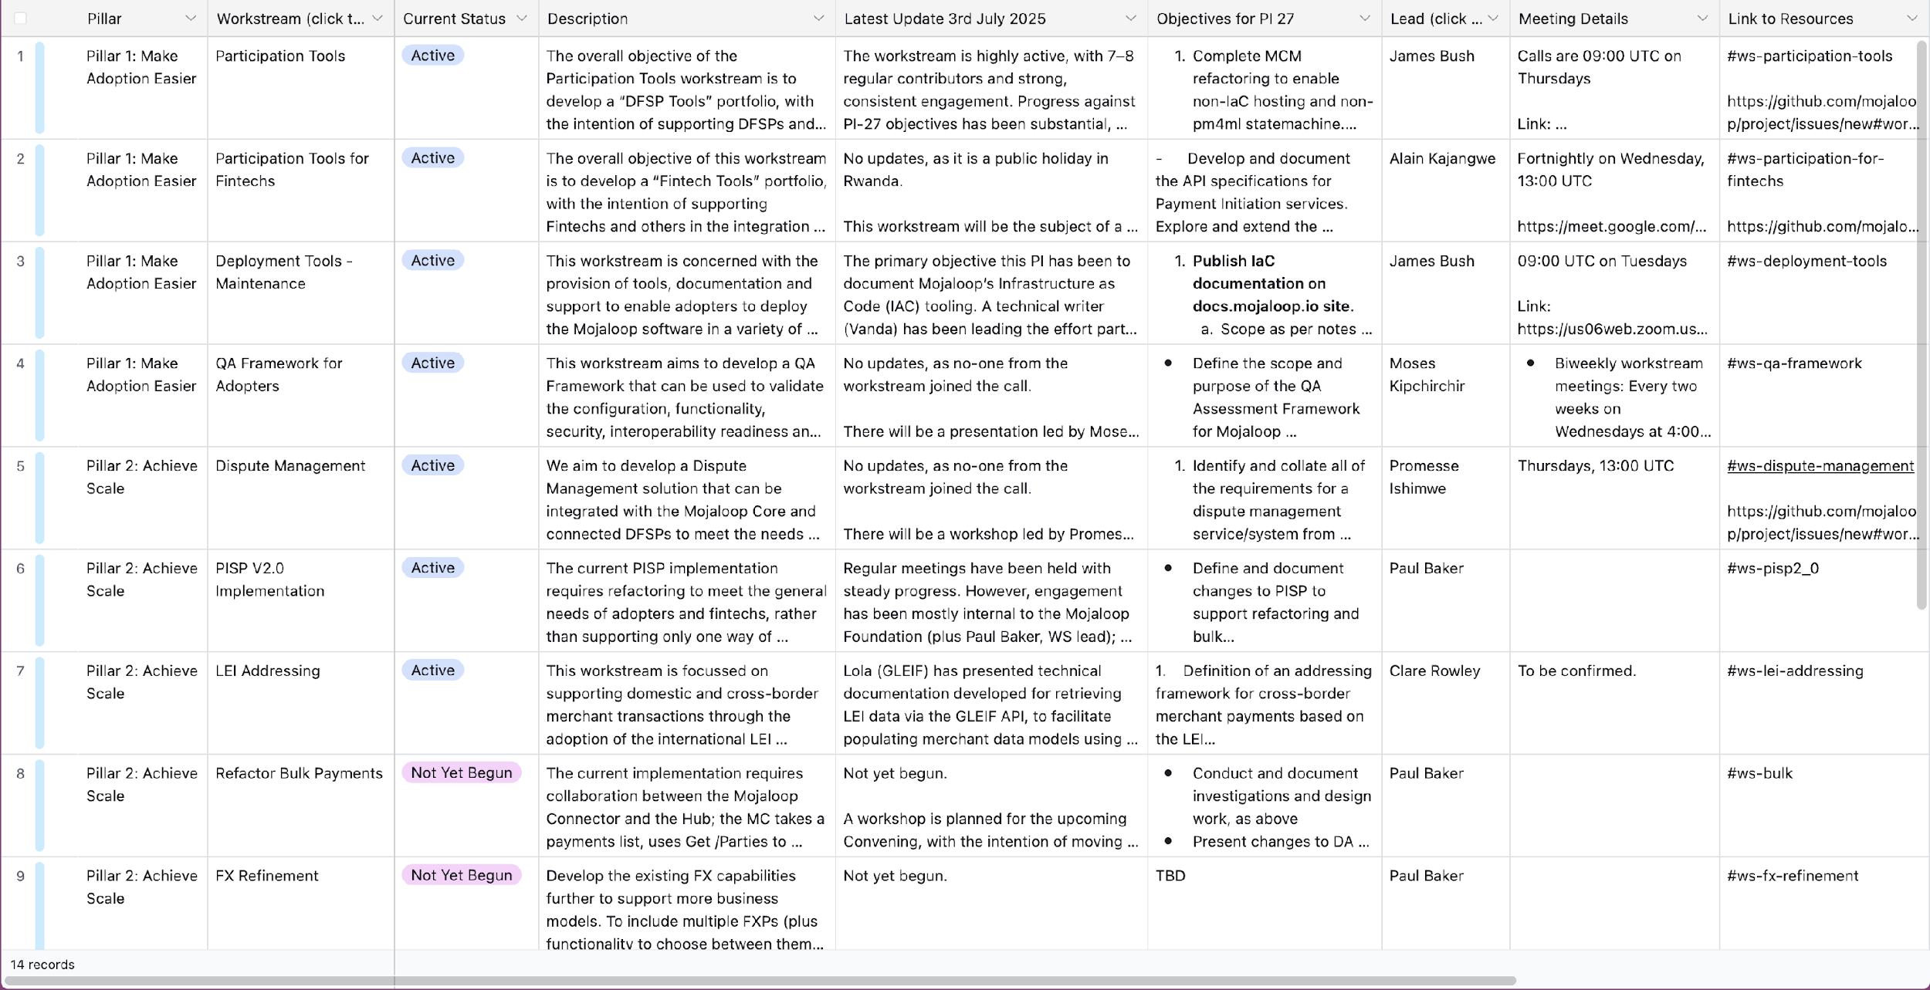

Slide 9
Incubation & GTM Projects
No individual-driven workstreams
Incubation projects:
Require Product Council approval
Governed and report to Product Council
GTM projects:
Channeled to MLF Director of Market Development & Partnerships

Slide 10
Summary
Clear structure ensures transparency and accountability
Collaborative processes managed by qualified leads
Supportive framework from MLF to guide success

Slide 11
Thank you
soriko@mojaloop.io

